Slide 1
An Introduction to the Multichannel Rendezvous Problem-Part III
Prof. Cheng-Shang Chang (張正尚教授)
Institute of Communications Engineering National Tsing Hua University
July 2025

Slide 2
The sym/async/hetero/local MRP (Oblivious rendezvous)
Symmetric: there are no distinguishable roles of users
Asynchronous: users' clocks may not be synchronized
Heterogeneous: users may have different available channel sets
There is no universal labelling of the channels.
In such an environment, nothing can be learned from a failed rendezvous attempt.

Slide 3
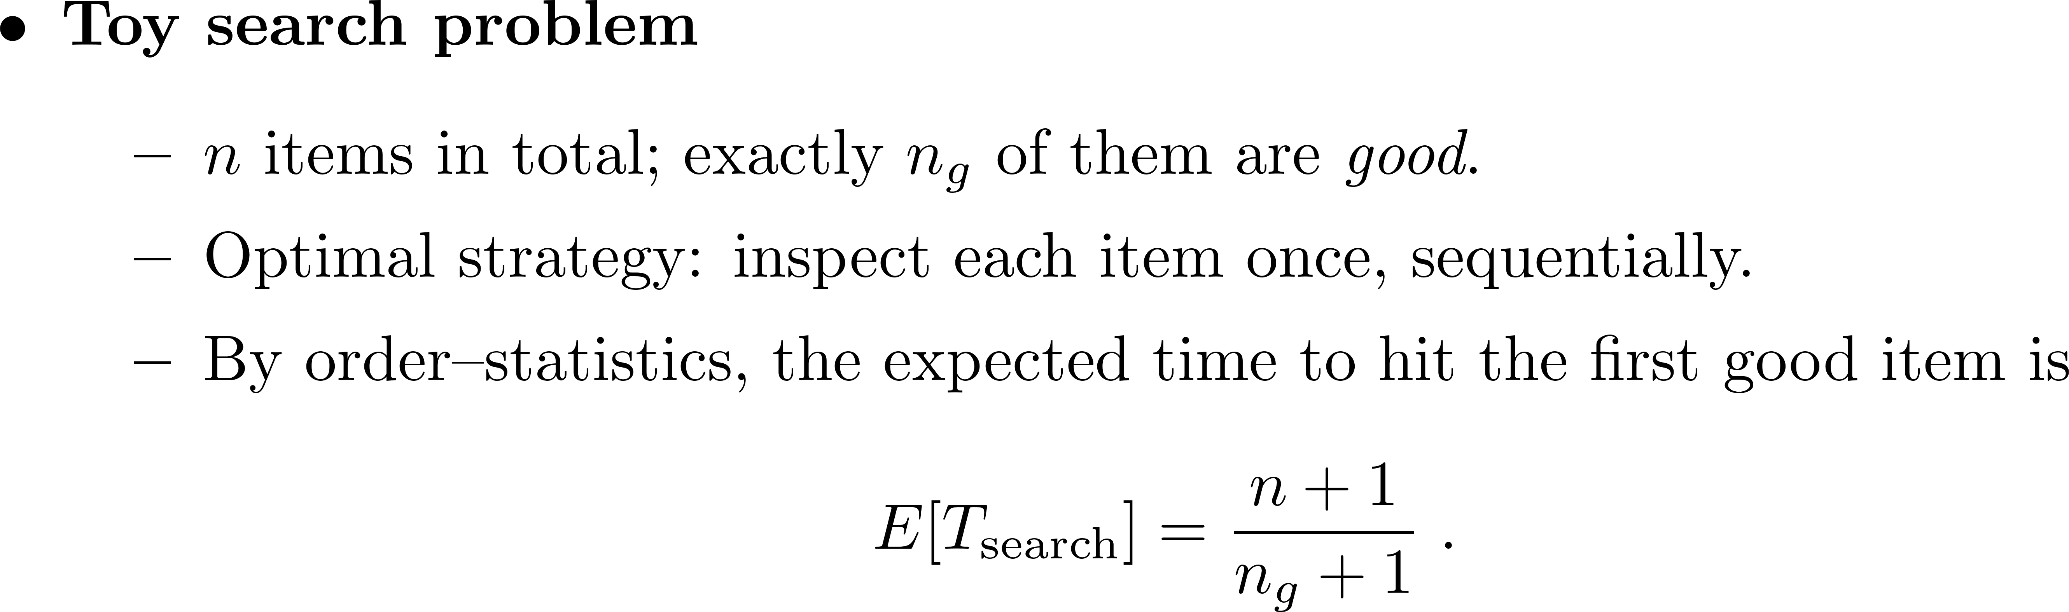
ETTR lower bound

Slide 4
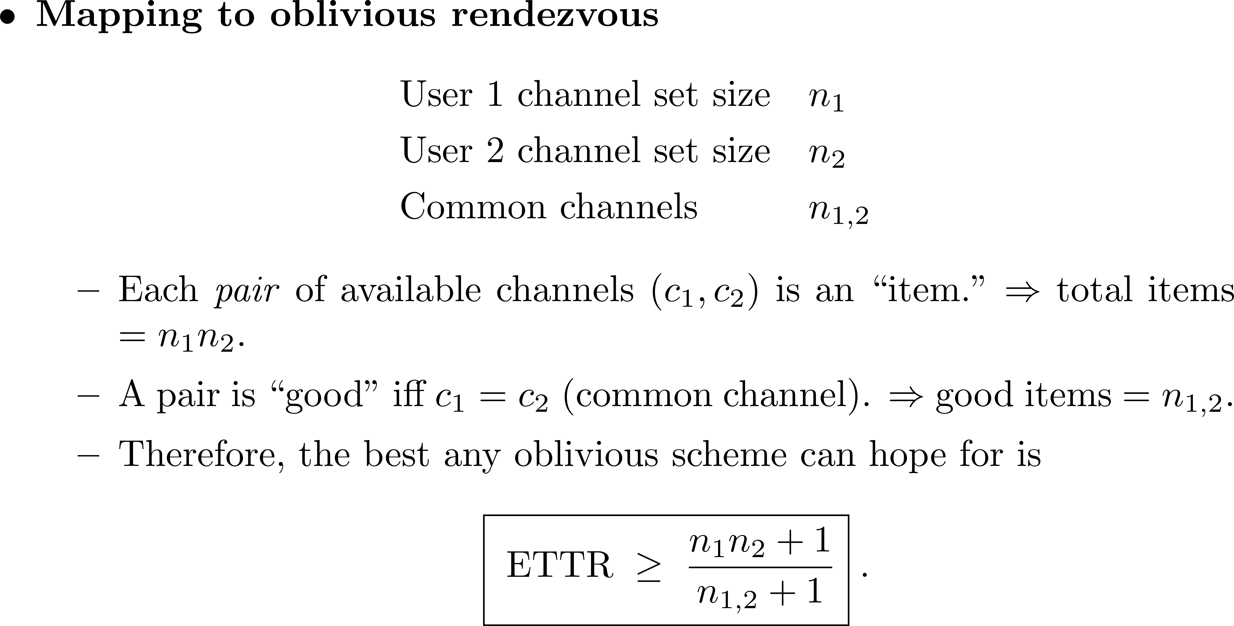
ETTR lower bound

Slide 5
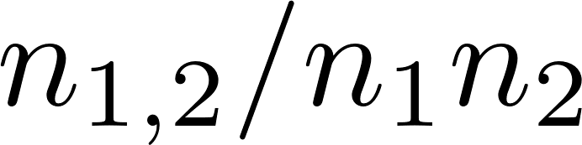
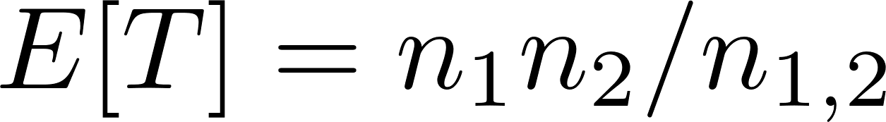
Coin-tossing (or dice-rolling) does not need clock synchronization
Each users uniformly and independently selects a channel to hop on at any time.
The TTR, T, is geometrically distributed with parameter .
This implies .
But there is no guarantee that these two users will rendezvous within a constant number of steps.
Can we beat this simple strategy?

Slide 6





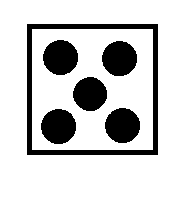
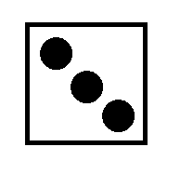
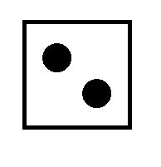






Blind Rendezvous(coin tossing)—The Random Algorithm
1
2
3
4
5

Slide 7
Blind Rendezvous(coin tossing)
1
2
3
4
5

Slide 8
How to break symmetry
Recall that the asymmetric setting is easy (the Chinese Remainder Theorem).
The key is to break symmetry of the two users.
Unique ID: every user (device) has a unique ID, e.g., MAC address or IP address

Slide 9
The ID/async/hetreo/local MRP (Unique ID)
One can map the unique ID for each SU (the 48-bit universal MAC address) to determine the roles (as a sender/child or a receiver/mommy).
Partition time into frames. In the k^{th} frame, if the k^{th} bit of the ID is
  0→sender/child,
  1→receiver/mommy.

Slide 10
Unique ID itself is not enough!
Suppose the ID of user 1 is 1010 and the ID of user 2 is 0101.
Synchronized
Differ by 1 frame
Frame 1 2 3 4 5 6
Frame 1 2 3 4 5 6
User 1 M-C-M-C-M-C
User 1 M-C-M-C-M-C
User 2 C-M-C-M-C-M
User 2 C-M-C-M-C

Slide 11
Need to be cyclically unique
Given a unique n-bit ID (b₀, b₁, … , b_{n-1}), the trick is then to transform the unique ID into another m-bit codeword (c₀, c₁, …, c_{m-1}) so that it is cyclically unique.
For any cyclic shift d, there does not exist another codeword (c₀’, c₁’,…, c_{m-1}’) that is the same as (c_{d}, c_{d+1}, …, c_{(m-1+d) mod m}).
Such a mapping is called a symmetrization mapping in the literature.

Slide 12
Two known symmetrization mappings
Method 1 (K. Bian and J.-M. Park, 2013): append the original n-bit ID with n consecutive 1's and n consecutive 0's. This results in a 3n-bit codeword.
Method 2 (I. H. Chuang, H.-Y. Wu, and Y.-H. Kuo, 2014): add a new symbol ``2'' in front of the n-bit ID. This creates a problem of dealing with the additional symbol ``2.'‘
Both methods add a delimiter.

Slide 13
Delimiter for framing a packet
The 01111110 bit sequence is commonly used as a delimiter for framing a packet.
One needs to make sure that the payload of a packet does not contain six consecutive 1's.
  Bit stuffing algorithm
  C-transform (C.-S. Chang, J. Cheng, T.-K. Huang and D.-S. Lee, 2014)

Slide 14
The 4B5B encoding table
The 4B5B encoding scheme is widely used in computer networks
Each 5-bit codeword has at most one leading 0 as well as at most two trailing 0's.
Concatenated codewords do not have 4 consecutive 0's.

Slide 15
The 4B5B symmetrization mapping
C.-S. Chang, C.-Y. Chen, D.-S. Lee, and W. Liao, ``Efficient encoding of user IDs for nearly optimal expected time-to-rendezvous in heterogeneous cognitive radio networks,'' IEEE/ACM Transactions on Networking, vol. 25, no. 6, pp. 3323--3337, 2017.

Slide 16
The 4B5B symmetrization mapping
The substring of 4 consecutive 0's appears exactly once in the M-bit codeword for any time-shift d.
If d is not zero, the 6-bit delimiters of two M-bit codewords are not aligned. Therefore, an M-bit codeword cannot be identical to any other codeword cyclically shifted by a nonzero d.
If d is 0, then the 6-bit delimiters of two M-bit codewords are aligned. The unique ID assumption guarantees the uniqueness of the M-bit codeword.

Slide 17
The sym/async/hetero/global MRP (eliminating the need of the unique ID assumption for labelled channels)
The MTTR bound is proportional to the length of an ID and the length of an ID is usually very long, e.g., a MAC address contains 48 bits.
Using the (mapped) ID to generate CH sequences makes it difficult for an SU to remain anonymous.
The main idea is to select at random an arbitrary channel in the available channel set of an SU as its ID (channel).

Slide 18
Eliminating the need of the unique ID assumption for labelled channels
The unique ID assumption is no longer valid as the two SUs might select one of their common channels as their IDs.
The second idea is to extend a binary ID to a ternary ID with elements in {0,1,2}.
When the symbol "2" appears, an SU simply stays on the channel that is used as its ID.
SUs with the same ID are still guaranteed to rendezvous.

Slide 19
The 4B5B ternary symmetrization mapping
C.-S. Chang, Y.-C. Chang, and J.-P. Sheu, ``A quasi-random algorithm for anonymous
rendezvous in heterogeneous cognitive radio networks,'' arXiv:1902.06933, 2019.

Slide 20
Three roles
0→sender/child: choose a period that is an odd number
1→receiver/mommy: choose a period that is a power of 2.
2→ stay mode: stay on the ID channel.

Slide 21
The quasi-random algorithm
Time interleaving three subsequences.
0-subsequence: modular clock with a prime p₀ not smaller than the number of available channels.
1-subsequence: modular clock with an prime p₁ not smaller than the number of available channels.
2-subsequence: stay one the ID channel

Slide 23
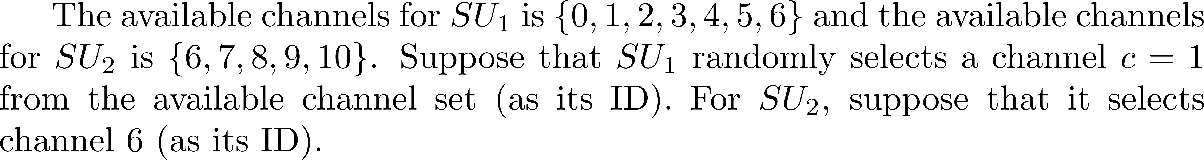

Slide 24
MTTR bound

Slide 25
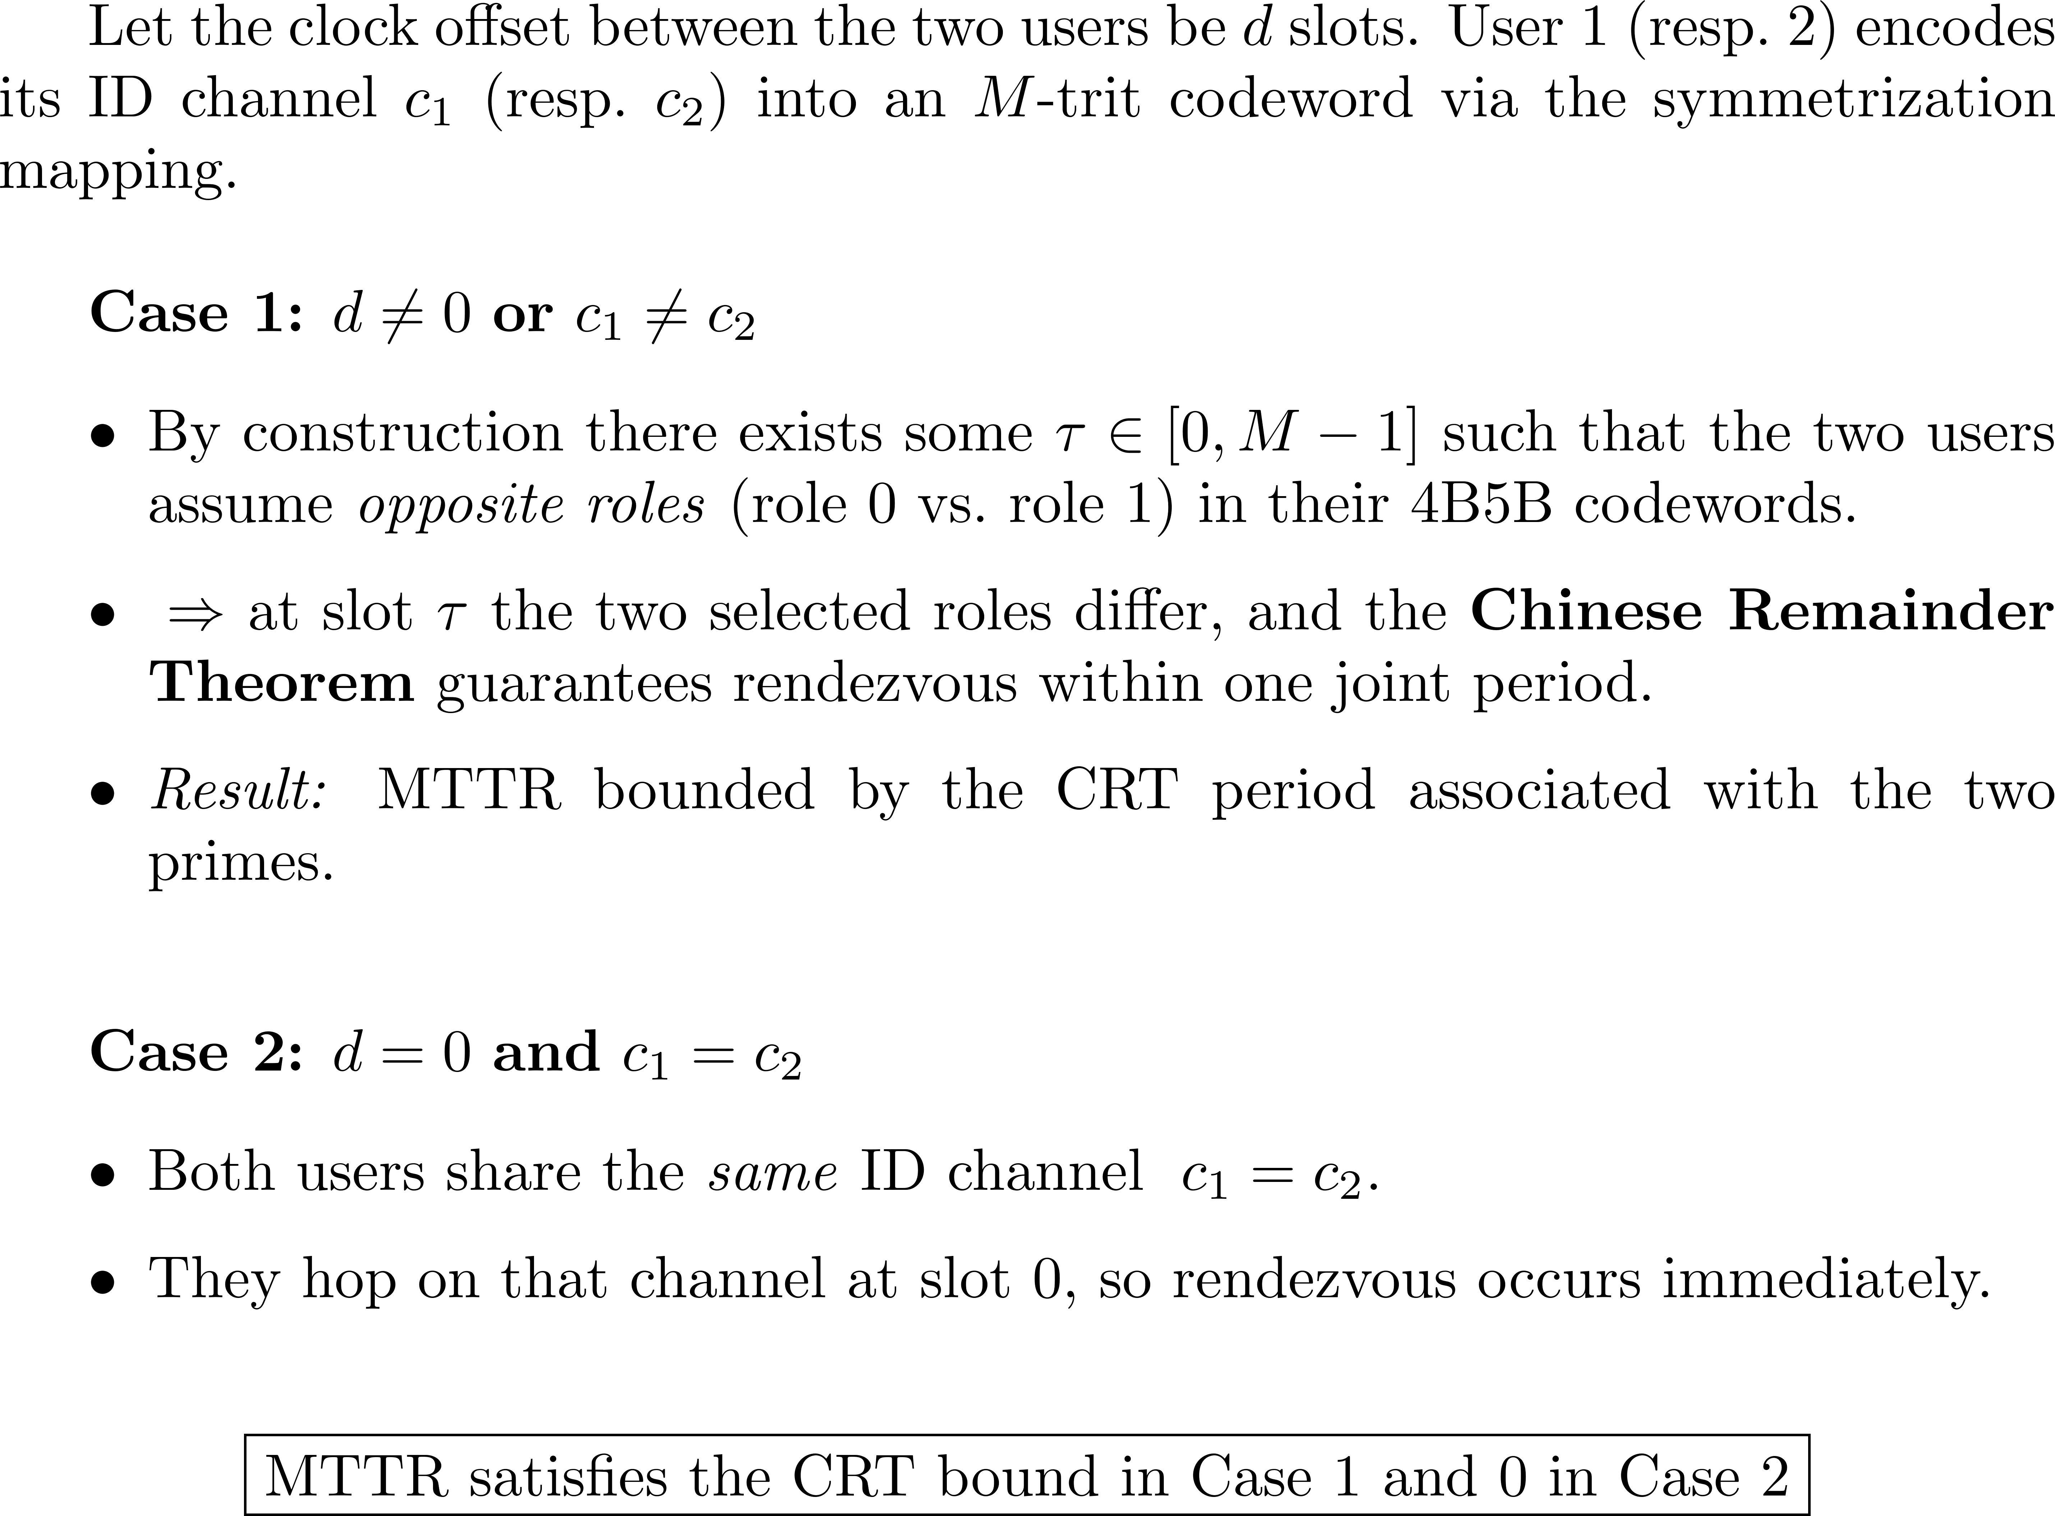

Slide 26
ETTR performance
The M channels in the first row are randomly generated.
The probability that the two users did not rendezvous during the first M time slots is small.
The ETTR of the QR algorithm is close to that of the random algorithm.
Thus, its ETTR performance is nearly optimal if nothing is learned from a failed rendezvous.

Slide 27
Complete symmetrization mapping
Consider a set of M-bit codewords
Let
be the vector obtained by cyclically shifting the vector w_{i} d times.
Y.-C. Chang, C.-S. Chang, and J.-P. Sheu, ``An enhanced fast multi-radio rendezvous algorithm in heterogeneous cognitive radio networks,'' IEEE Transactions on Cognitive Communications and Networking, vol. 4, no. 4, pp. 847--859, 2018.

Slide 28
Complete symmetrization mapping

Slide 29
Manchester encoding
Replace a bit 0 by the two bits 01
Replace a bit 1 by the two bits 10

Slide 30
The Manchester complete symmetrization mapping
0100011101

Slide 31
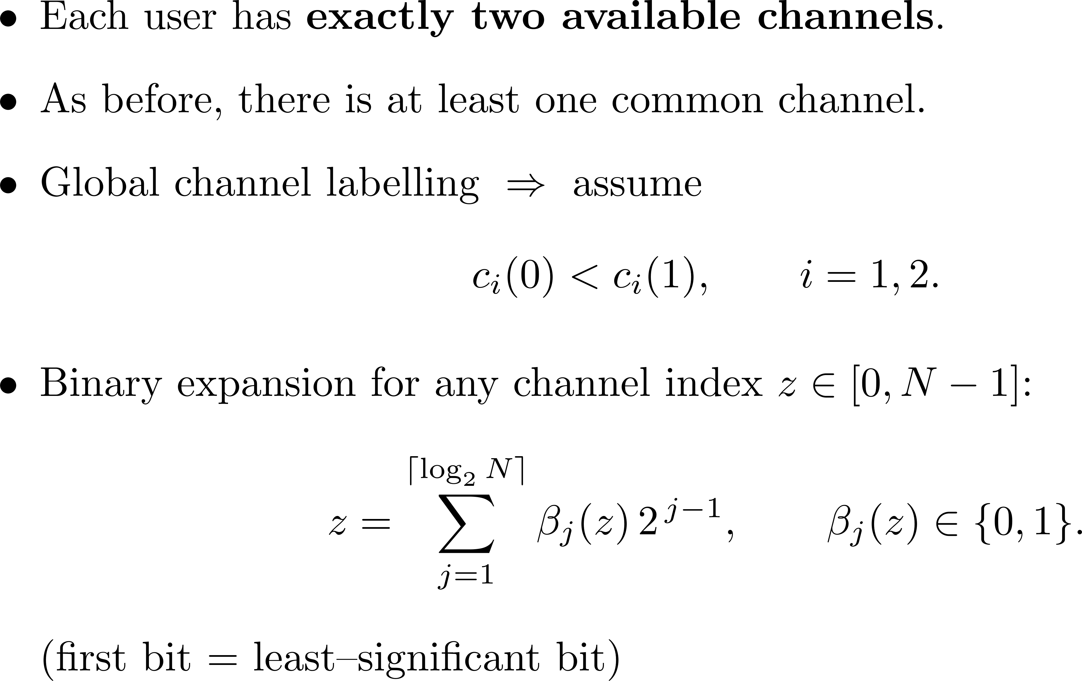
Two‐channel users

Slide 32
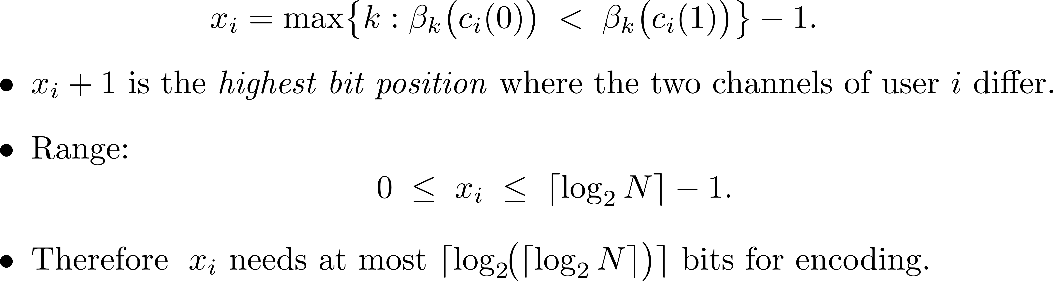
Largest differing bit
Z. Gu, H. Pu, Q.-S. Hua, and F. C. M. Lau, ``Improved rendezvous algorithms for heterogeneous cognitive radio networks,'' Proceedings of IEEE INFOCOM, pp. 154--162, 2015.

Slide 33
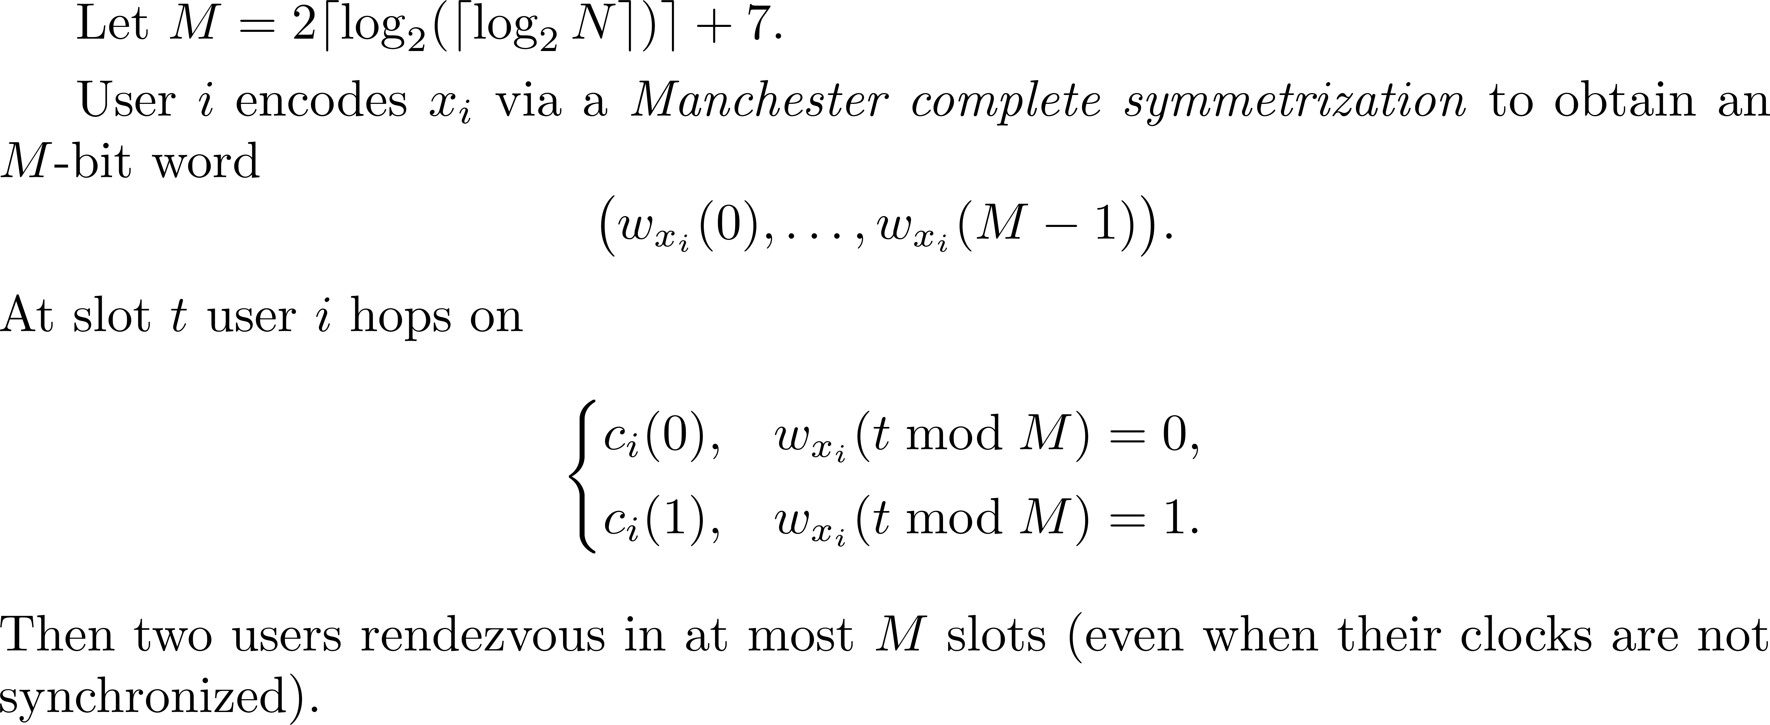
MTTR bound

Slide 34
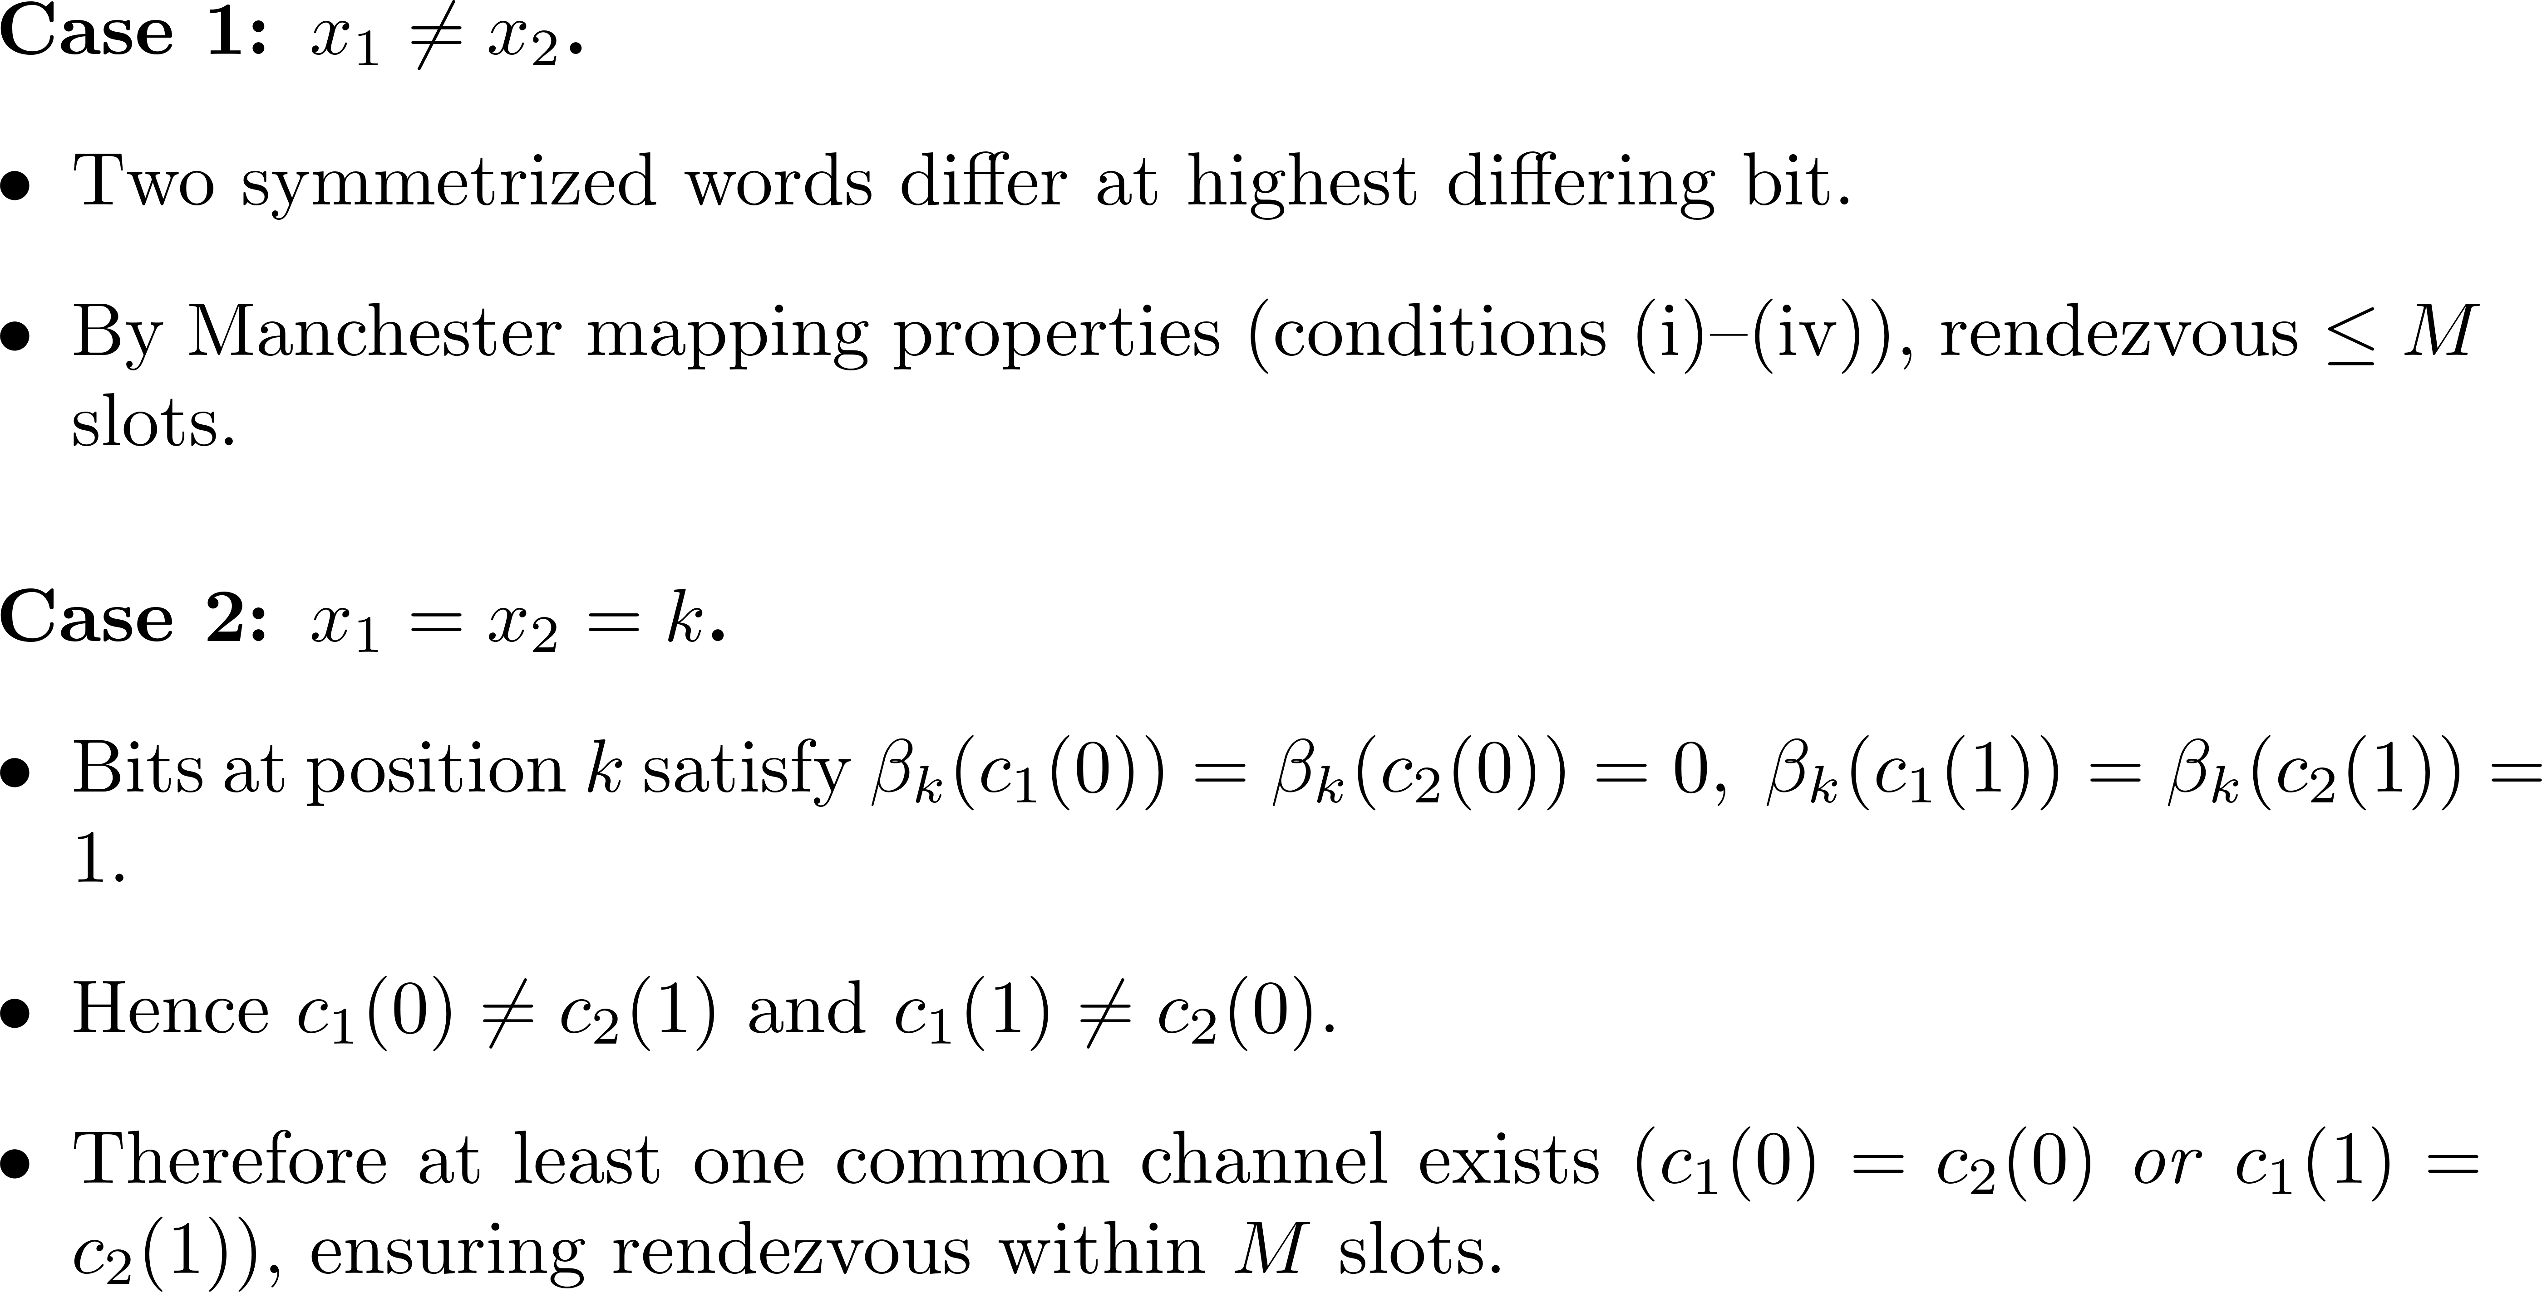
Proof Sketch
(0,0), (0,1), (1,0), (1,1)

Slide 35
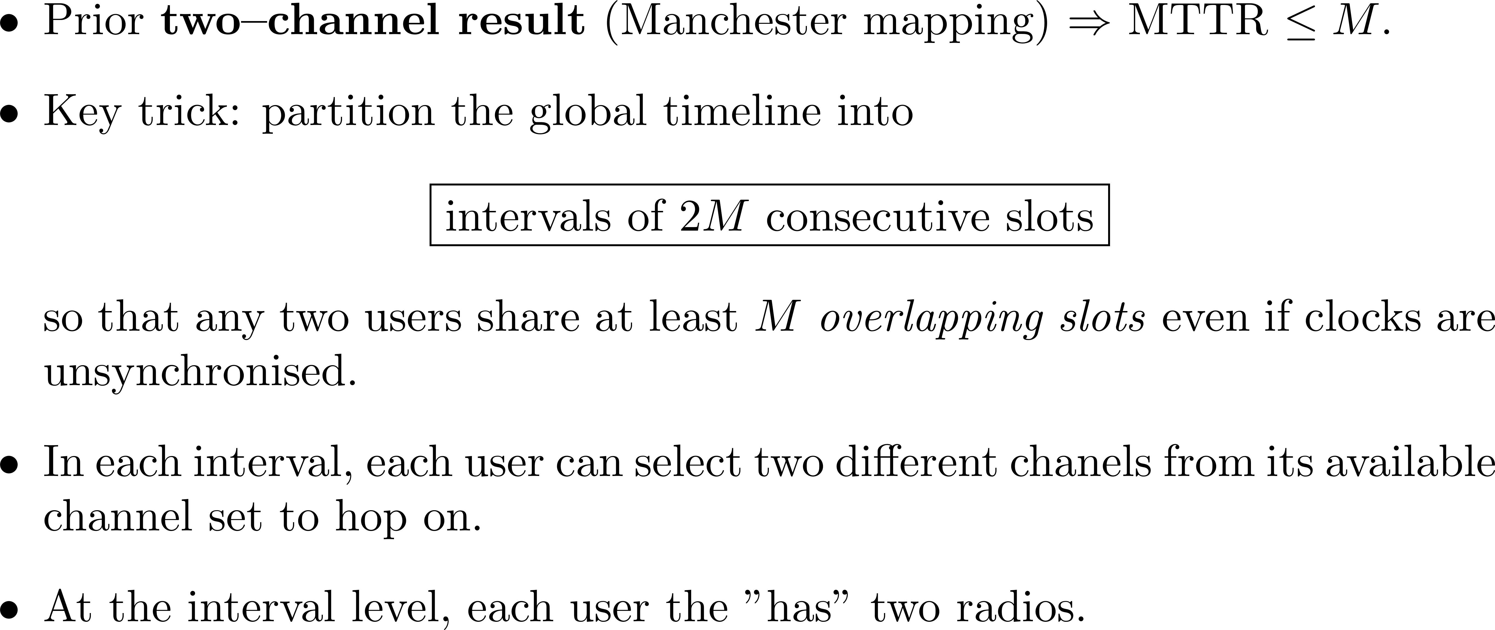
Applying the results for two-channel users to the sym/async/hetero/global MRP

Slide 36
Two-prime modular clock algorithm
Use the two-prime modular clock algorithm at the interval level.
User i can select two different primes p_{i,0} and p_{i,1} ( ).
Run the modular clock algorithm with p_{i,0} (resp. p_{i,1} ) for the first (resp. second) radio of user i.
Since there is at least one prime selected by user 1 that is different from one of the two primes selected by user 2, it follows from the Chinese Remainder Theorem that these two users will rendezvous within p_{1,1} p_{2,1} intervals.

Slide 37
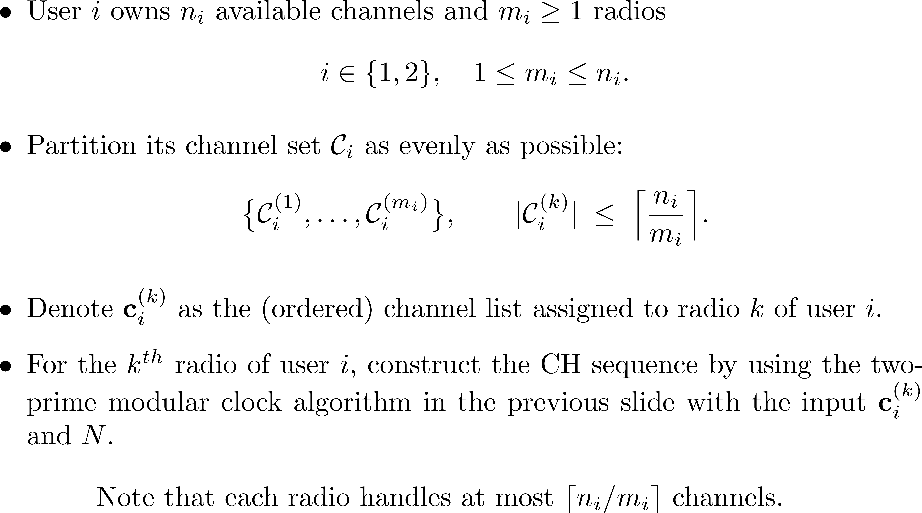
Extension to multiple radios

Slide 38
The MTTR bound of the two-prime modular clock algorithm with Manchester complete symmetrization mapping
N commonly labelled channels
n₁ (resp. n₂) is the number of available channels to user 1 (resp. 2)
m₁ (resp. m₂) is the number of radios for user 1 (resp. 2).
MTTR is not greater than
where

Slide 39
Summary: two basic approaches
Symmetry breaking: this class of methods breaks the symmetry of the two users by using IDs (or ID channels in user's available channel sets). Once the symmetry is broken, the two users can play different roles in time. The Chinese Remainder Theorem can then be used.
Combinatorial designs: this class of methods uses the algebraic structure of various combinatorial designs to guarantee rendezvous, including Galois fields, finite projective planes, orthogonal Latin squares, quorum systems, difference sets, and ideal matrices.

